Slide 1

Title: Online Ticket Reservation System
Student Name: A Charanteja
Student ID: 2520030418)
Cluster:03
Section: 12
Under the Guidance
of
Supervisor Name: DR.Chaitanya Kumar
Assistant Professor
Department of CSE

Slide 2
OUTLINE
Abstract
Existing System
Proposed System
System Architecture
Project Modules
Objectives
Co’s Attainments - FWD
Co1
Co2 …….. 5. Co5
Co’s Attainments - DSA
Co1
Co2 …….. 5. Co5
Screen Shots for FWD & DSA
Conclusion
Geo-Tagged Photos

Slide 3
Abstract
Online Ticket Reservation System is a software application used to book tickets digitally.
The system helps users reserve tickets easily without visiting booking counters.
It stores passenger information and booking details efficiently.
Data Structures like Queue and Linked List are used to manage reservations and waiting lists.
Searching and sorting techniques help retrieve passenger information quickly.
The system improves speed, accuracy, and convenience in ticket booking.

Slide 4
Existing System
Manual ticket booking requires physical presence.
High waiting time at booking counters.
Ticket availability checking is slow.
Manual record maintenance is difficult.
Higher chances of data loss or mistakes.
Managing cancellations and waiting lists is complex.

Slide 5
Proposed System
Automated ticket reservation process.
Quick search for available tickets.
Automatic waiting list management using Queue.
Stores passenger records digitally.
Faster ticket confirmation process.
Reduces human errors in booking.

Slide 6
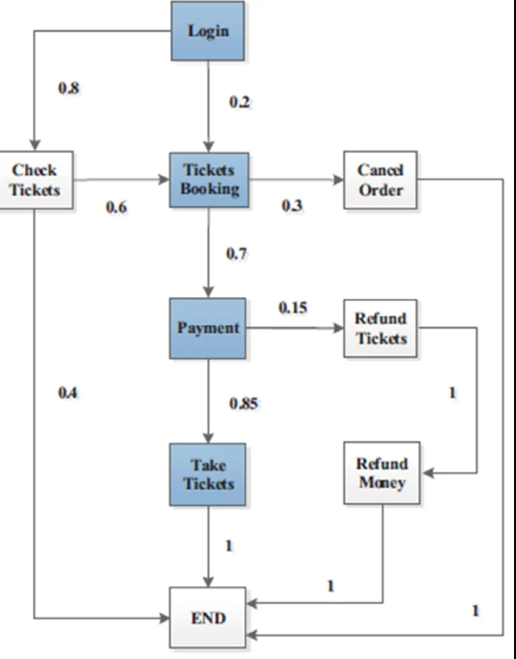
System Architecture

Slide 7
Project Modules
Login Module – User authentication.
Passenger Details Module – Stores passenger information.
Seat Availability Module – Checks seat status.
Booking Module – Reserves tickets.
Cancellation Module – Removes ticket from system.
Report Module – Displays booking records.

Slide 8
Objectives
To design a user-friendly booking system.
To manage ticket reservations efficiently.
To demonstrate the application of DSA concepts.
To improve ticket management processes.
To reduce booking time and complexity.

Slide 9
Co’s Attainments - DSA
CO1: Understand fundamental data structures.
CO2: Apply Queue for waiting list management.
CO3: Implement Linked List for passenger records.
CO4: Apply searching and sorting algorithms. Analyze efficiency of data structures in real applications.

Slide 10
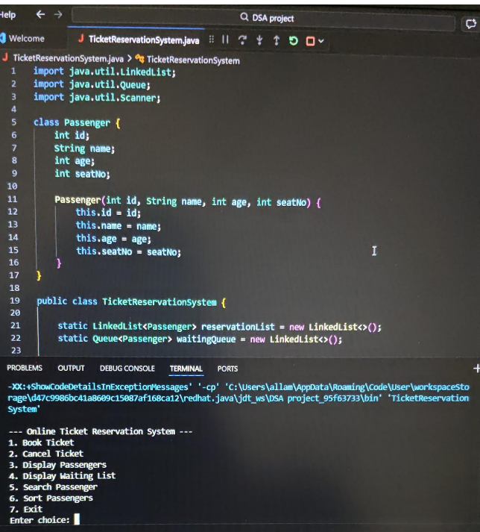
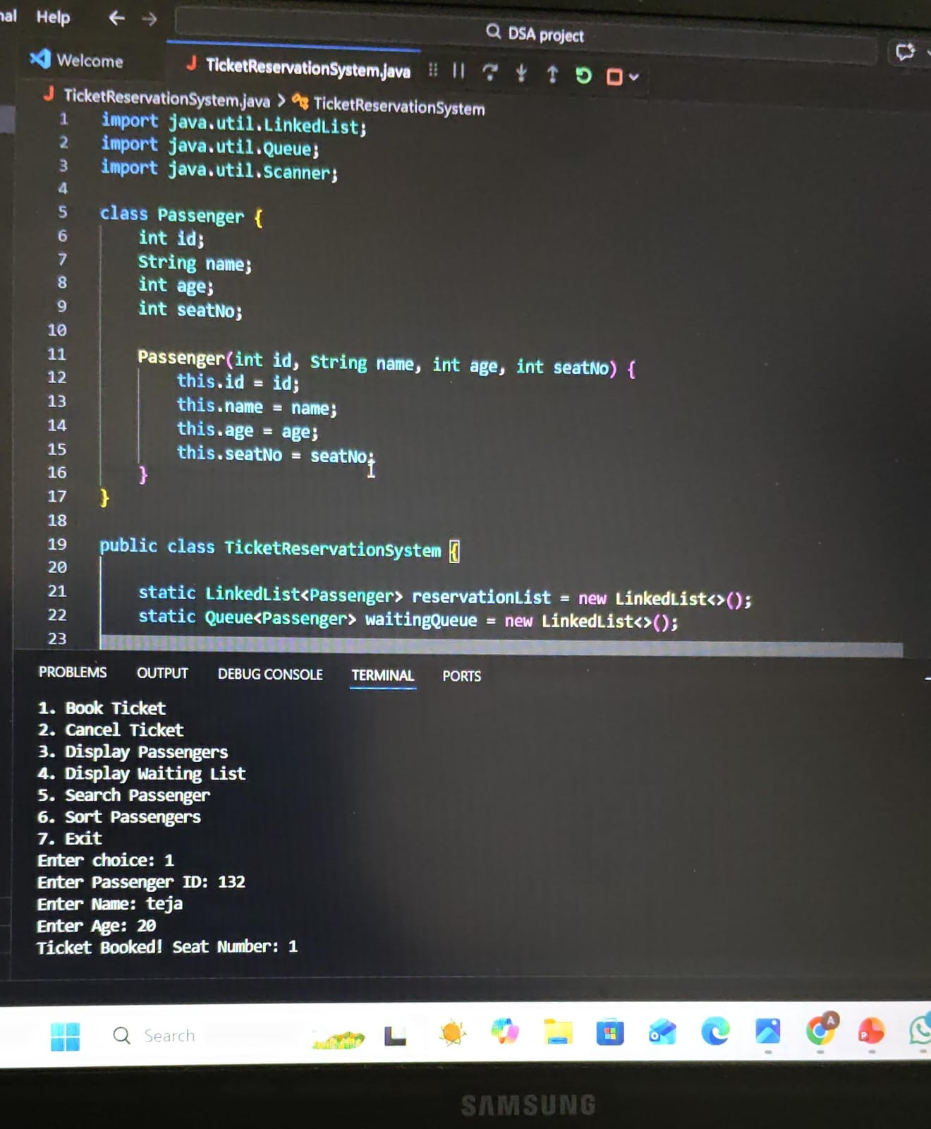
Screenshots for DSA

Slide 11
Conclusion
Simplifies the ticket reservation process.
Saves time for passengers and administrators.
Efficient use of Queue and Linked List data structures.
Improves reliability of ticket management systems.
Can be expanded into a real-world railway or bus reservation system.

Slide 12
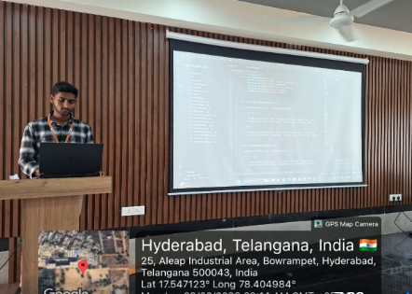
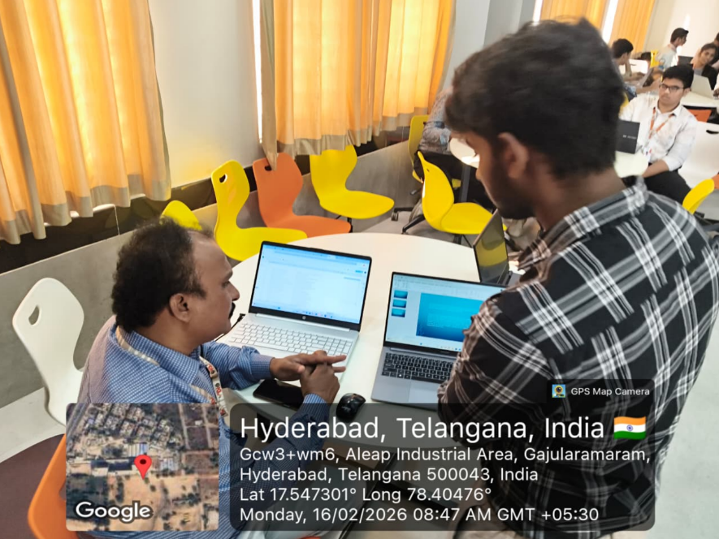
Geo- Tag Photos

Slide 13
THANK YOU

